Slide 1
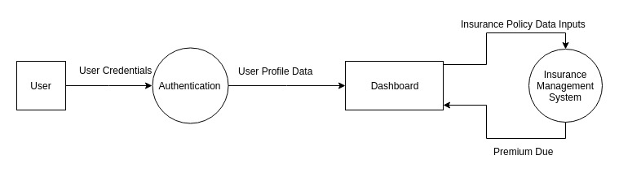
Insurance Aggregator System

Slide 2
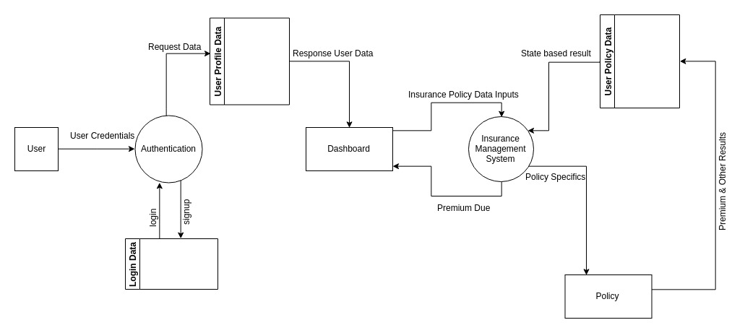
Insurance Aggregator System

Slide 3
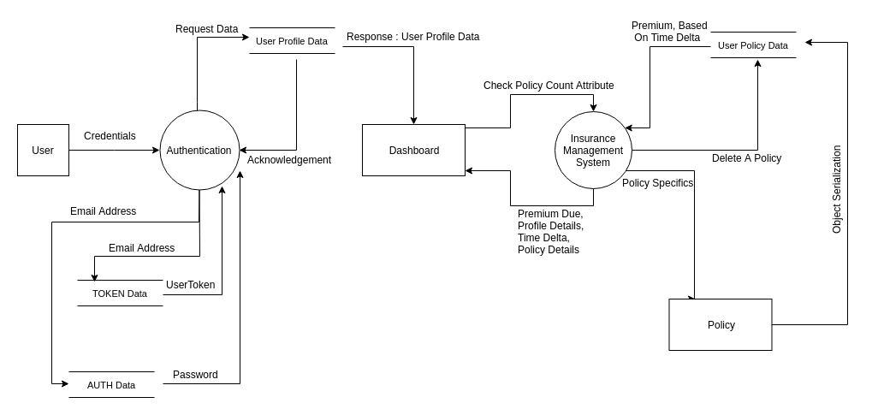
Insurance Aggregator System

